Slide 1
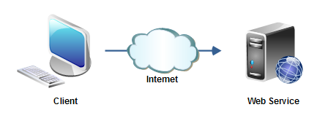
Web Services Overview
The term "web service" is often used to describe a service that a client (a computer) can call remotely over the internet, via web protocols like HTTP. Like calling a method, procedure or function which is running on a different machine than the client.
As such web services are very similar to "remote procedure call" (or just "remoting") protocols, like Java's RMI, Windows DCOM, Corba's IIOP etc.

Slide 2
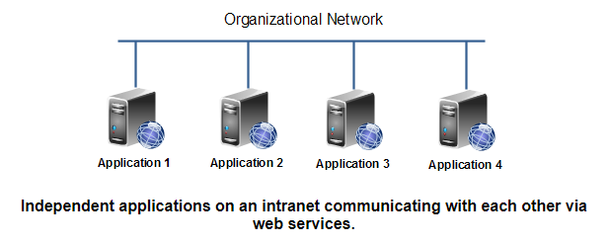
Web Services Overview
Web services can also be used internally in an organizations network, as a way to allow many different applications to interact with each other. The standardized web service protocols then makes it easier to integrate the various applications

Slide 3
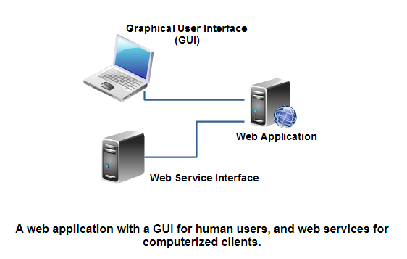
Web Services Overview
The main difference between a web service and a web site is, that a web site is typically intended for human consumption (human-to-computer interaction), whereas web services are typically intended for computer-to-computer interaction.
A web application can contain both a graphical user interface for human users, as well as a set of web services for computer "users" (clients). For instance, a payment service like Paypal has both a graphical user interface for human users, as well as a set of web services through which you can have your own backend systems access the Paypal services.
This below diagram shows a web application that contains both a graphical user interface, and a web service interface (a set of web services exposing selected functions of the web application)

Slide 4
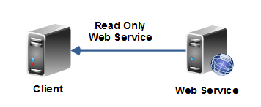
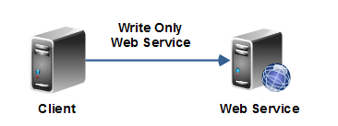
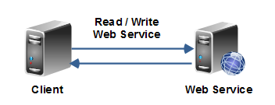
Web Services Overview
There are multiple types of web services. Some web services a client calls to obtain some information. For instance, a client may call a weather web service to read weather information. These are typical read-only web services. A read-only web service may in practice send an empty request to the web service, which then sends the data back. So, even if a web service is read-only, the client might actually have to send some data (a minimal request) to the web service to obtain the data it wants to read.
Other web services are more write-only kind of web services. For instance, you may transfer data to a web service at regular intervals.
And then others are read-write services where it makes sense to both send data to the web service, and receive data back again.

